Slide 1

Agile and Azure DevOps (Tool)
Presented by Crystal Tenn
Notes:
Welcome to the Azure DevOps fundamentals session

Slide 2
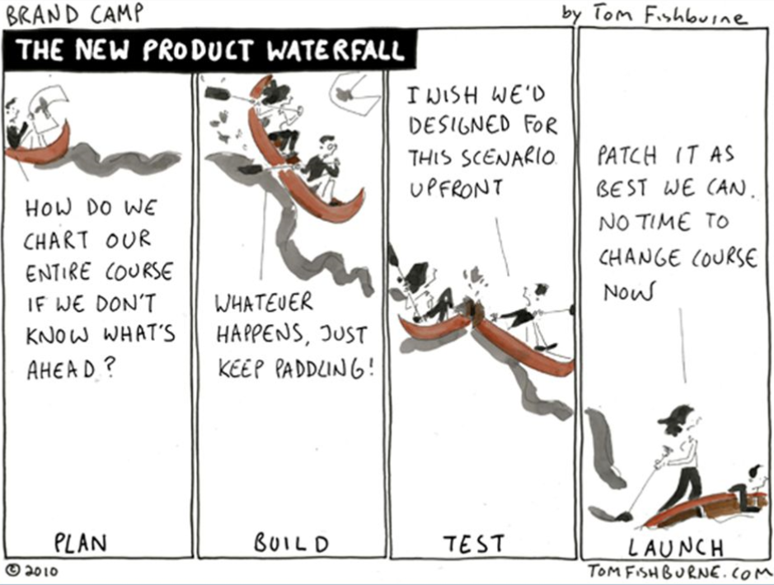
History Lesson: Waterfall

Slide 3
What is Agile?

Slide 4

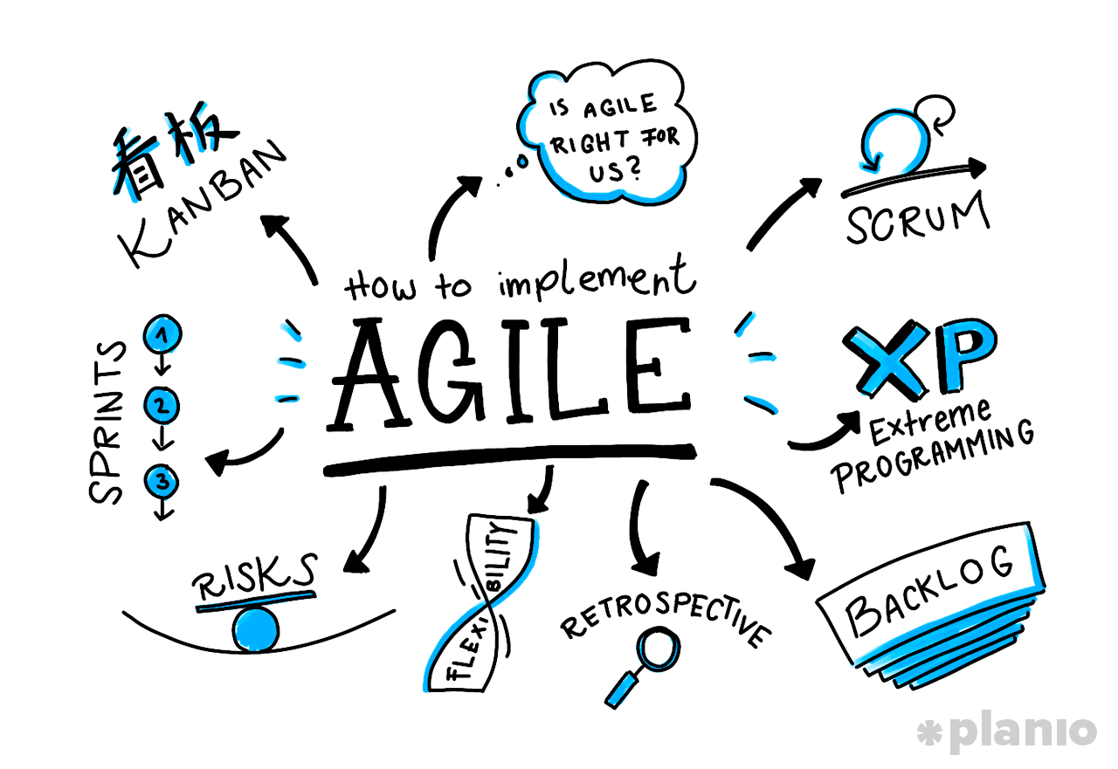
A set of Values and Principles.

Slide 5
Agile Methodologies: Scrum and Kanban

Slide 6
Scrum is an Agile framework for completing complex projects.

Slide 7
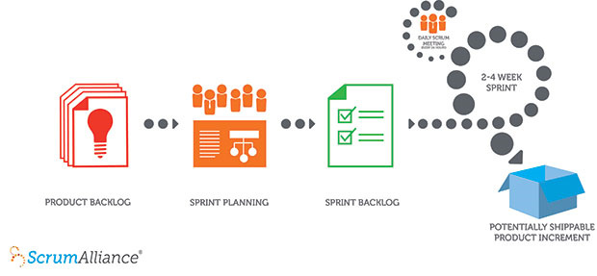
Scrum in 30 seconds
First, create a prioritized list called a product backlog.
During sprint planning, the team pulls a small chunk from the top of the sprint backlog, and decides how to implement those pieces.
The team has a sprint (usually 2-4 weeks) — to complete its work, but meets daily to assess progress (daily Scrum standup).
The ScrumMaster keeps the team focused.
At the end of the sprint, the work should be potentially shippable: ready to hand to a customer or demo.
The sprint ends with a sprint review and retrospective.

Slide 8
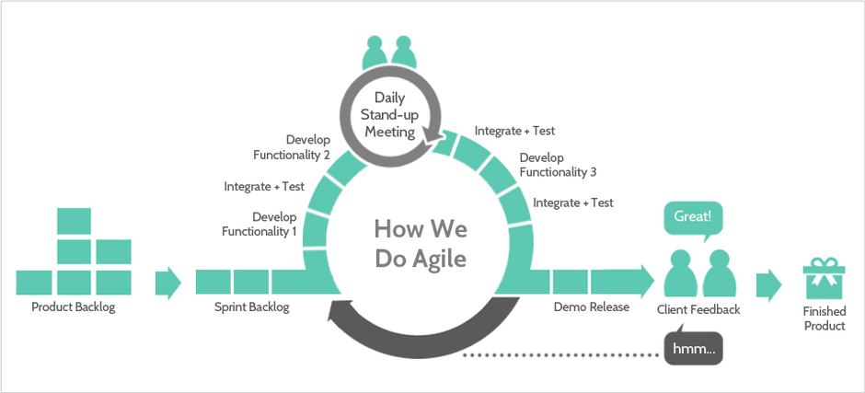

Slide 9
Kanban is another agile framework that requires real-time communication of capacity and full transparency of work.

Slide 10
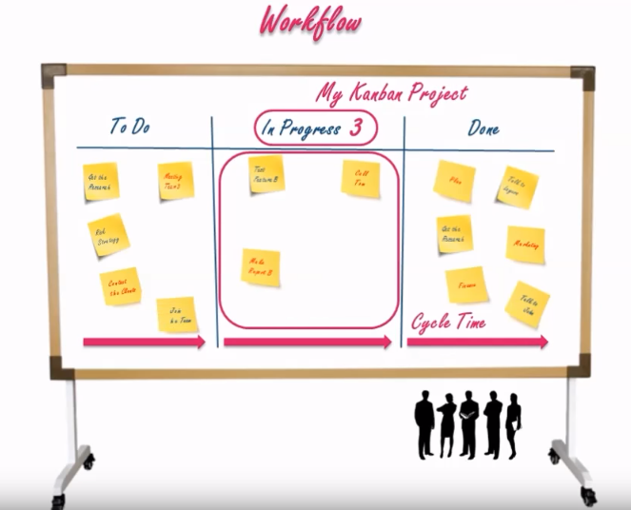
Kanban in 30 seconds
A project has a board that lives as long as the project.
As new work is needed, it is added to the to do side and color prioritized.
Limited work should be in progress at one time.
Once work is completed it is moved to the done side.
Work is completed based on priority and as team members get capacity.

Slide 11
Let’s compare Scrum and Kanban…

Slide 12

Differences between Scrum and Kanban: Scheduling
Scrum processes place heavy emphasis on completing a shippable product within each 2-4 week sprint. Anything outside of the sprint must be pushed to a future sprint.
On a Kanban team, there are no required time boxes or iterations. While the Kanban method is iterative in nature, the continual improvement is expected to occur as work is continually completed.

Slide 13

Differences between Scrum and Kanban: Team Members
On scrum teams, 3 roles must exist: the Product Owner, Scrum Master, and Team Members. A team must have all the resources necessary to complete the entire sprint’s work on their own.
Under Kanban, no set roles are prescribed. Teams can share resources. Members can fulfill multiple roles.
Branch
Manager
Assistant Branch Manager
TEAMWORK MAKES
THE DREAM WORK

Slide 14

Differences between Scrum and Kanban: Boards
In Scrum, columns are labeled to reflect periods in the work flow. All the stories added to the board at the beginning of each sprint should be found in the final column at the end of that sprint or the sprint was unsuccessful. Board is reset for each new sprint.
On a Kanban board, the columns show work flow states and a maximum value for the In Progress state. No reason to reset the Kanban board as work progresses. It will continue to flow for as long as the project continues, with new stories being added as the need arises.

Slide 15
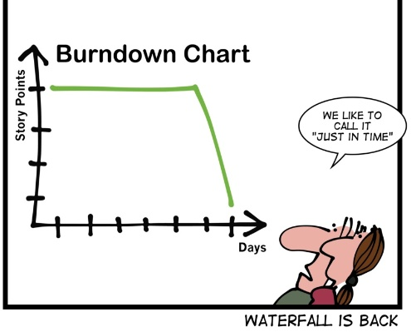
Flashbacks

Slide 16


Too good to be true?
A
B

Slide 17
… a journey of continued improvement.
A
B

Slide 18
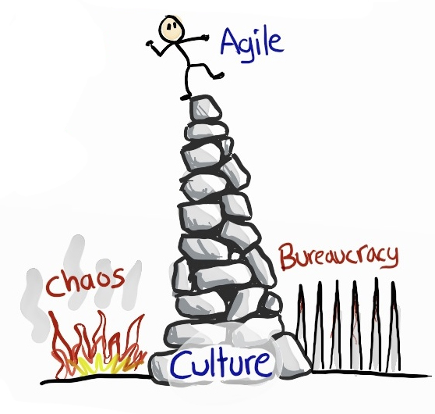
Build and Protect the Culture!

Slide 19
The Tools

Slide 20
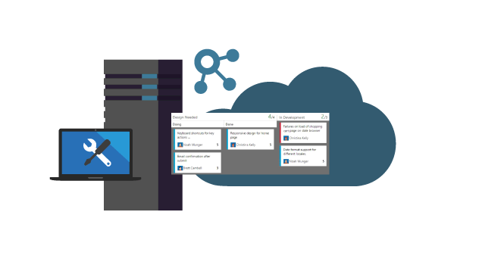
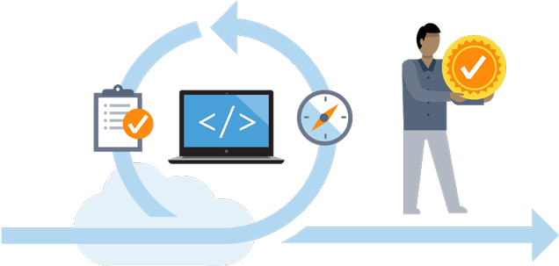
Azure DevOps Server (2019+)
Azure DevOps (Cloud offering)
Previously known as
Team Foundation Server (TFS) – (2018, 2017, 2015, 2013, 2012, 2010)
Previously, previously..
known as Visual Studio Team System 2008, 2005
Previously known as Visual Studio Team Services (VSTS)
Previously, previously known as Visual Studio Online (VSO)

Slide 21
Frequent Updates – 3 week sprints
Internal Private Repo
PREVIEW
Azure DevOps
Azure DevOps Server
Notes:
VSTS benefits from an accelerated release cycle. This does not mean that new features are buggy.
While spending a lot of time dogfooding new features, we also have a concept of private and public preview. This matches many of our other cloud services.
<Start animation>
For example:
We might be developing a feature in the private preview that only certain accounts have access to. Depending on the feature customers can request access.
Once the feature is more stable it will usually roam (first white arrow) into the public preview. Users can opt into and out of public preview features through the UI.
If the new feature is a per-user feature, users will see the prompt (for example new build editor) in their projects. If the new feature is a per-account feature, only users with admin access to the account settings will see a prompt to opt in/out. If a single user chooses to use a new per-user feature, it only applies to them.
After both public and private previews yield positive results, a feature is pushed to VSTS vCurrent. New features arrive - usually - every three weeks.
Any features that work well in VSTS and are considered “stable” roam into TFS with a feature update. These feature update usually release every 3-4 months. Only stable features will release to TFS and features may be skipped to maintain compatibility with older versions of TFS. This is due to the obvious challenges that come with providing hotfixes and out-of-band updates to an on-premises product.
There is a facility to provide hotfixes to TFS, but this would only be used for critical (security impacting) bugs.

Slide 22

References
Coming Soon! (Roadmap):
https://docs.microsoft.com/en-us/azure/devops/release-notes/
Latest updates!
https://docs.microsoft.com/en-us/tfs/server/whats-new
https://docs.microsoft.com/en-us/visualstudio/releasenotes/tfs2018-relnotes
Delivery Plans Extension:
https://marketplace.visualstudio.com/items?itemName=ms.vss-plans
Analytics Extension:
https://marketplace.visualstudio.com/items?itemName=ms.vss-analytics
Visualization Extension:
https://marketplace.visualstudio.com/items?itemName=ms-devlabs.WorkItemVisualization
Notes:
Good project start with good planning
In order to know what you want to build, you need to have a way to track the tasks and pieces that are needed
So to do that, you typically use a planning tool just VSTS, Jira, Rally, etc. That becomes the place where your engineering staff tracks their daily work. This is critical for the leads of the project to organize and schedule work so that the right pieces get completed at the right time.
Using a plan tracking tool also allows you to measure and track the completion of these work items and see that you are working towards your overall goal of adding new features and delivering value to your end users.
It is important to note that when you are trying to move to a DevOps mindset, that it does not necessarily require that you follow and agile process for engineering work. However, agile practices do tend to produce better results and help move the needle on getting these cycles up and running quicker.
If you work in an agile approach, you allow your stakeholders to provide feedback quicker to your planning process where you can make adjustments and corrections along the way before it gets too late in the overall project lifecycle.
Way for developers to track their day to day work.
Once we have a plan in place and engineers start taking tasks off the backlog, we can now move towards the next phase of DevOps….

